Slide 1
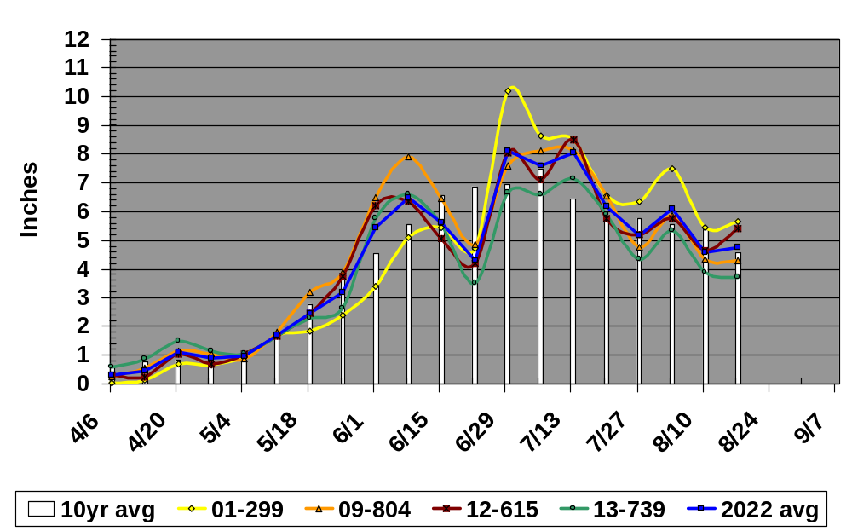
Growth Measurements 2022
Average Growth – Plant Cane

Slide 2
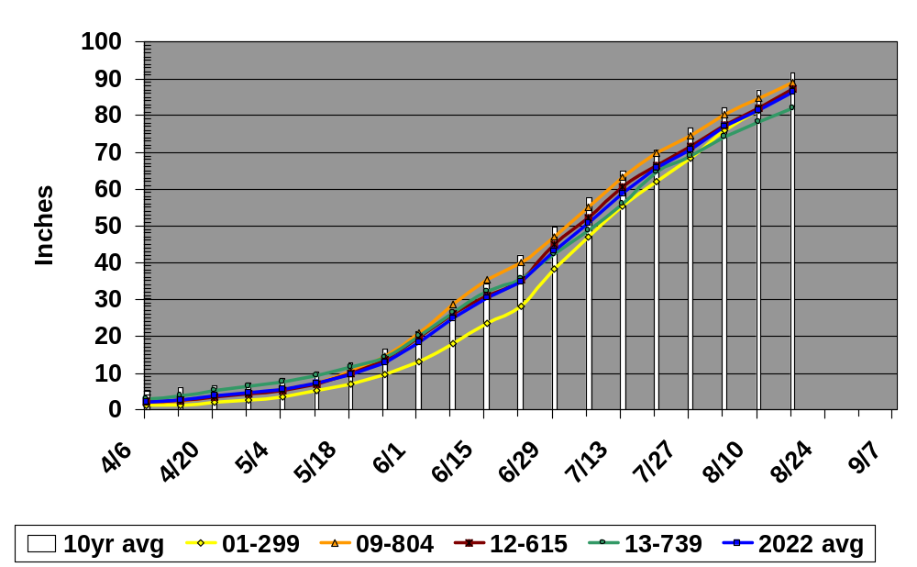
Growth Measurements 2022
Average Height – Plant Cane

Slide 3
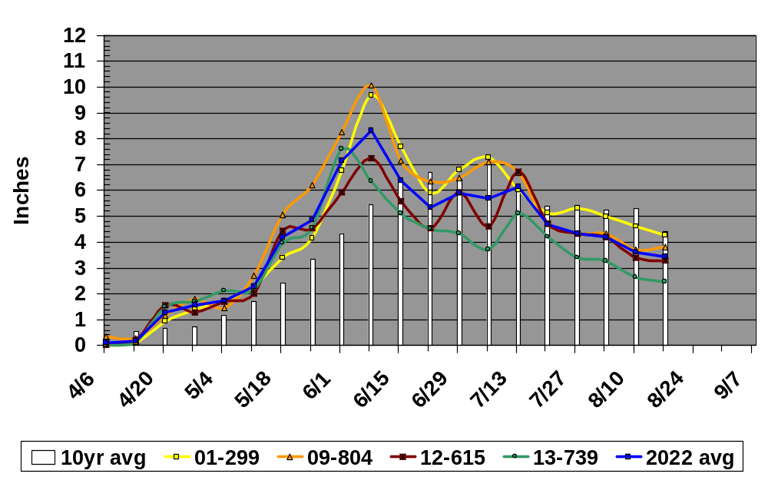
Growth Measurements 2022
Average Growth – First Stubble

Slide 4
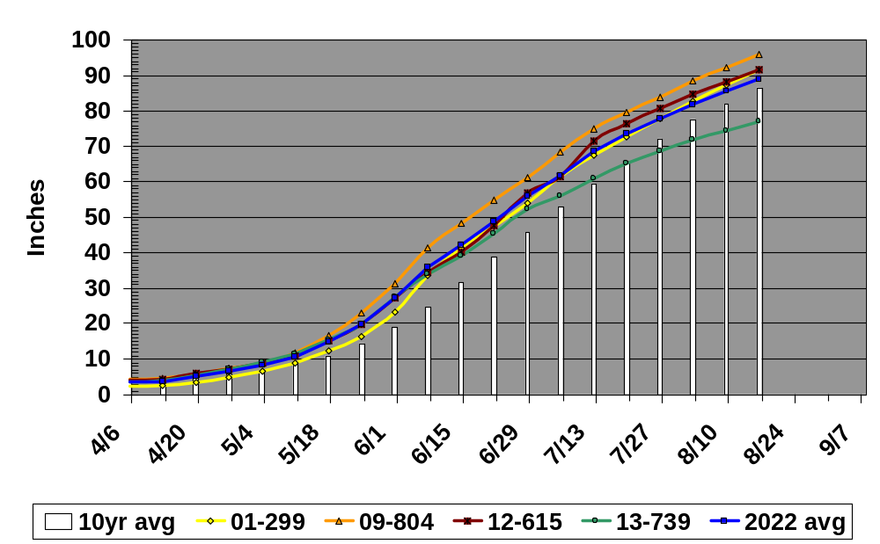
Growth Measurements 2022
Average Height – First Stubble

Slide 5
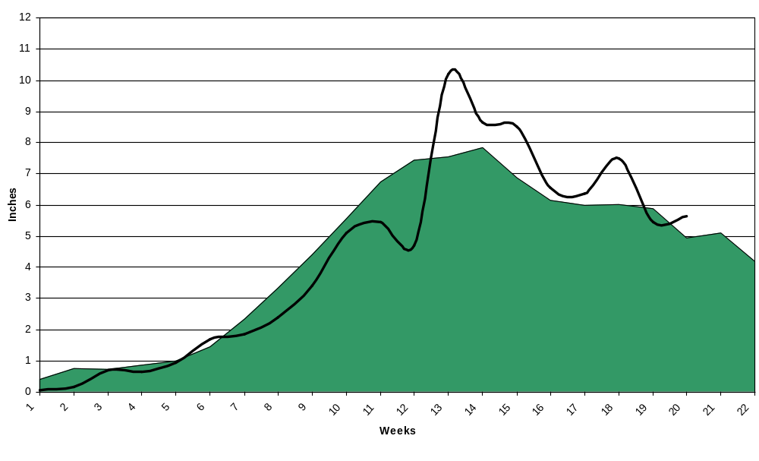
Average Growth – L 01-299
Plant Cane
2022
Avg. 2012 - 2022

Slide 6
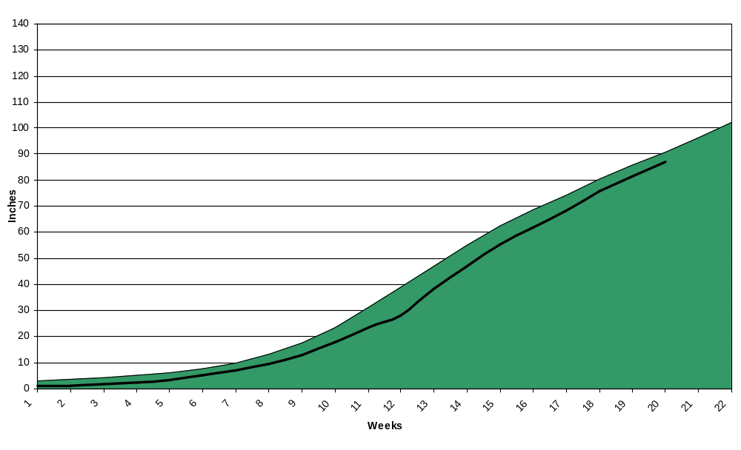
Average Height – L 01-299
Plant Cane
2022
Avg. 2012 - 2022

Slide 7
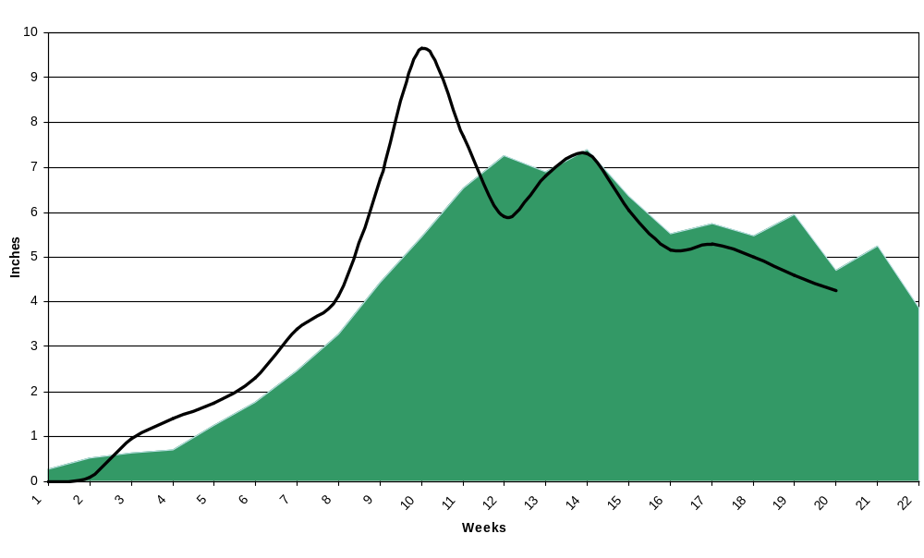
Average Growth – L 01-299
First Stubble
2022
Avg. 2012 - 2022

Slide 8
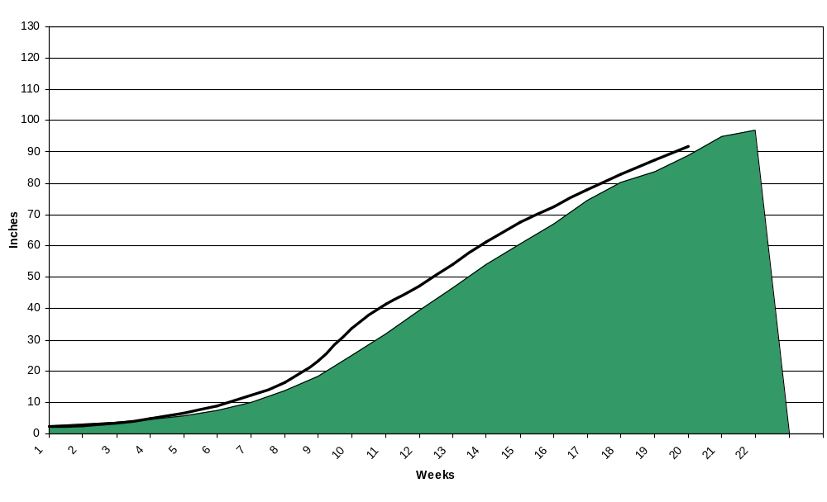
Average Height – L 01-299
First Stubble
2022
Avg. 2012 - 2022

